Slide 1
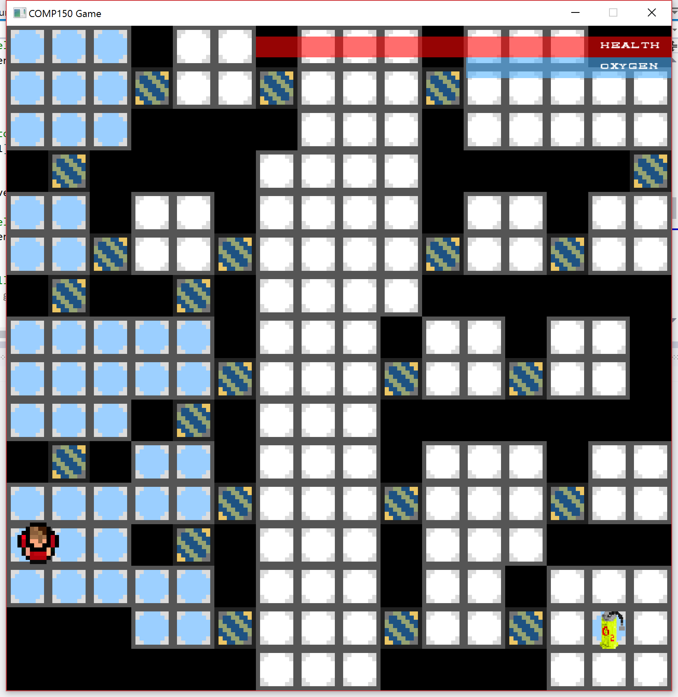
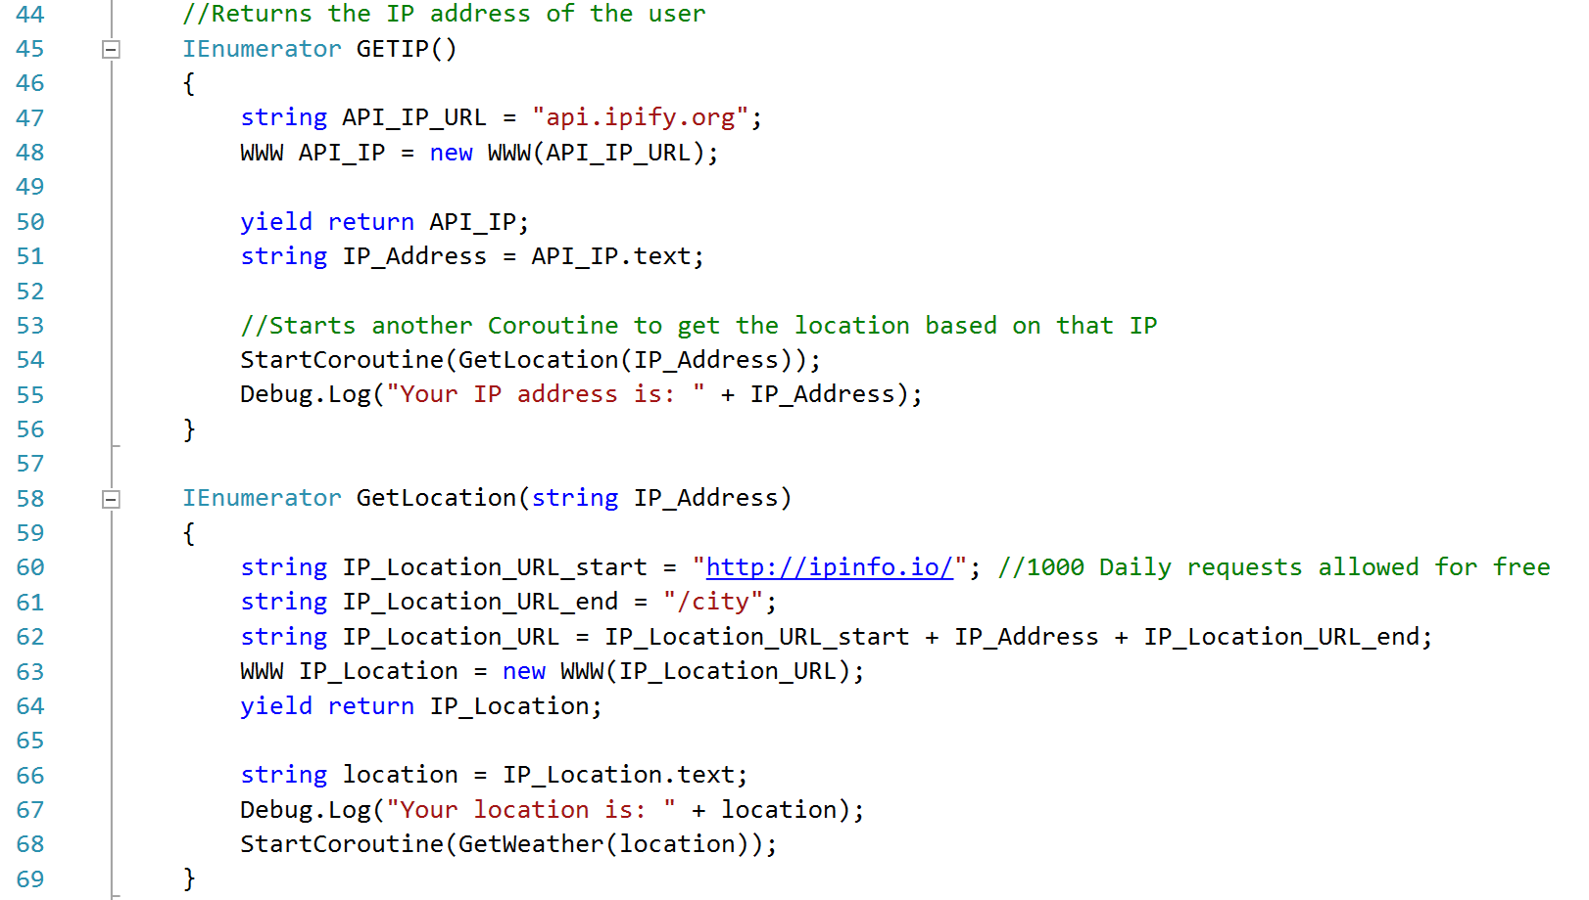

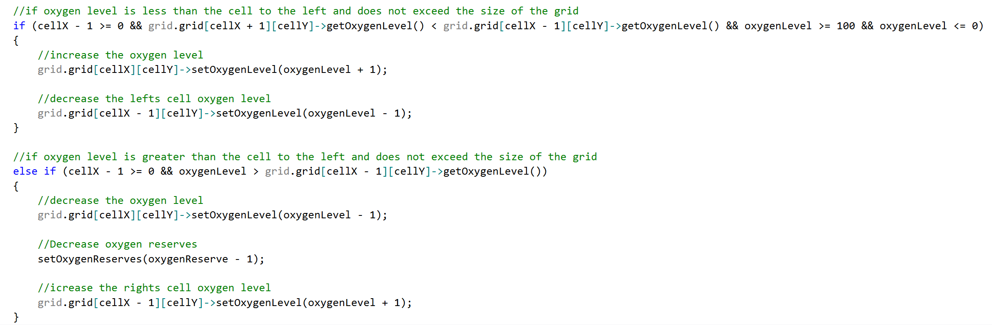
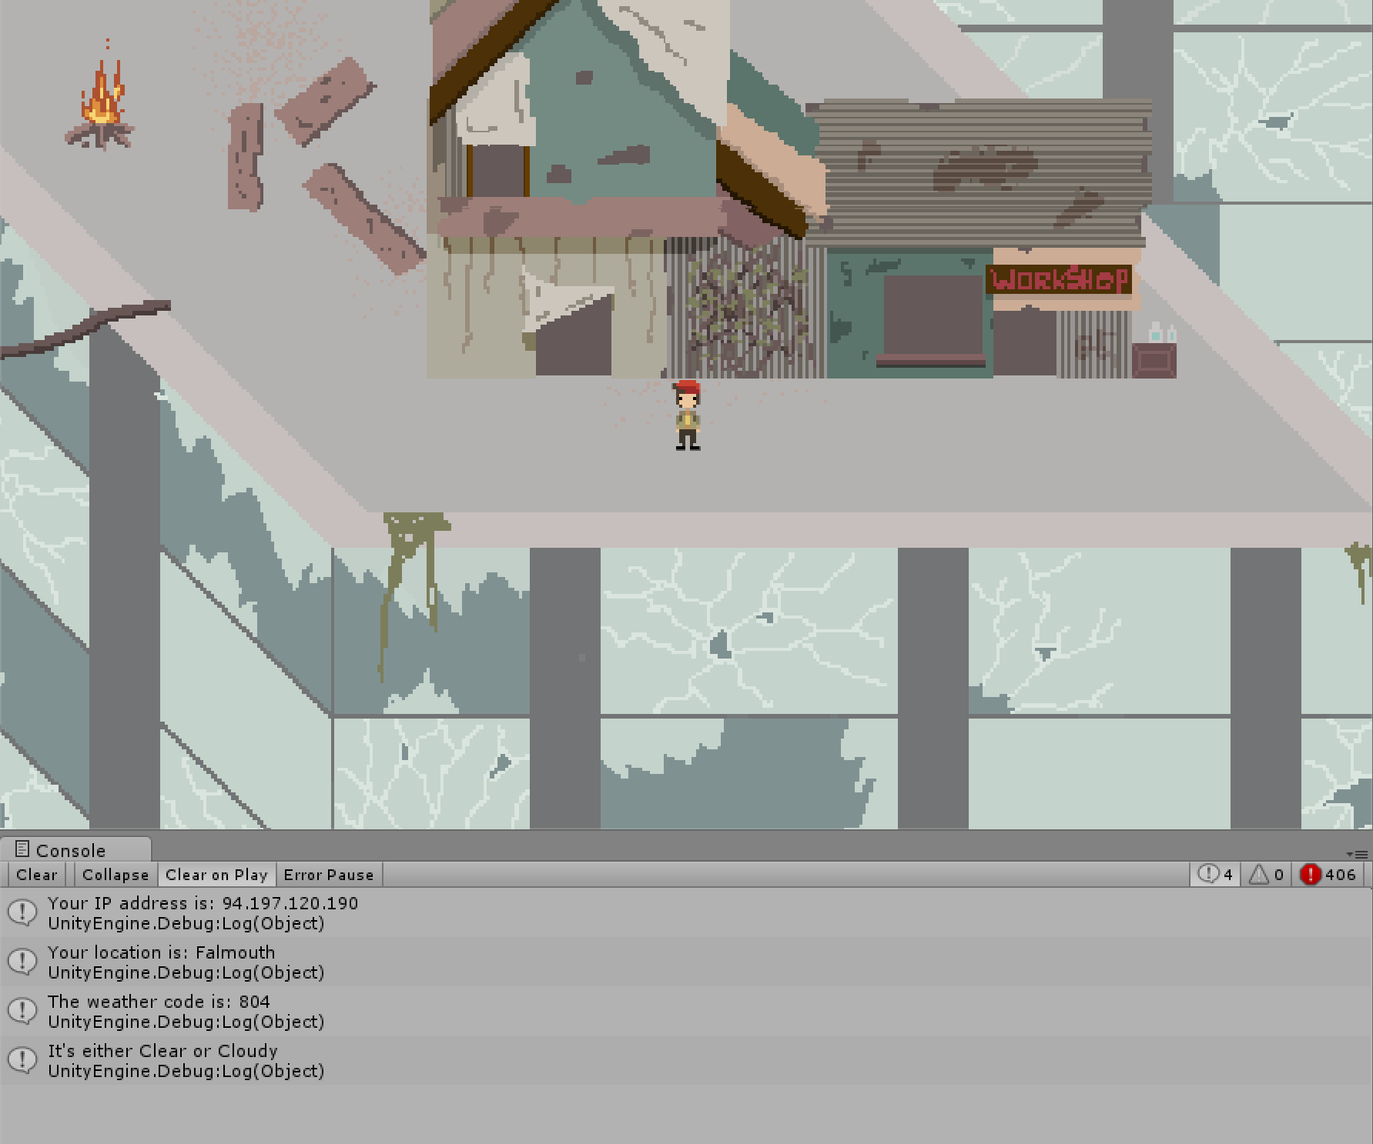
Coding Task II & Weather API
Oxygen Coding Task II
Weather API
This weather API for the BA game Relics.
This script will check the players location based on their IP address and then use a weather API to set the weather to the players current weather at their location.
This is the code that checks the IP address and location of the player.
An Image of the code working in game and setting the weather to clear

